Slide 1
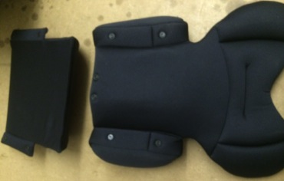
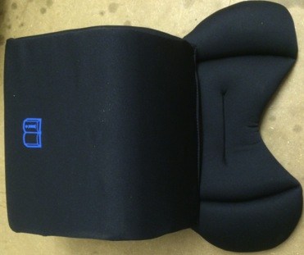
Using the Joie I-Anchor newborn insert
The new style insert comes in 3 pieces.
Body
Head
Wedge
First align and connect the 4 plastic studs on the wedge and body piece, and connect so it looks like this.

Slide 2
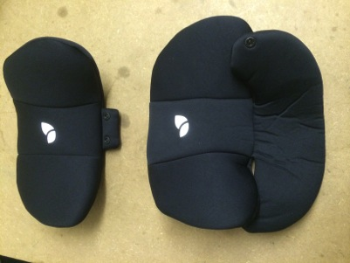
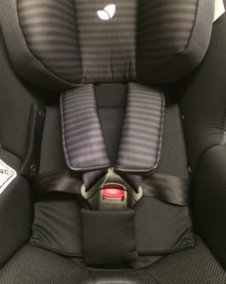
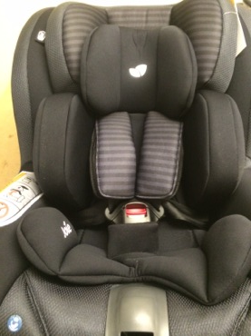
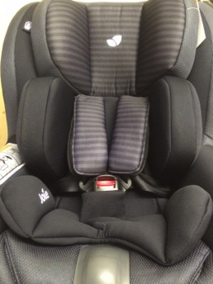
There are 2 versions of the head section the older style is independent of the body section, the newer style will connect using the 2 plastic studs to the body section. Either can be used with the new style insert.
Head section until approx 4-6months
Body section until approx 9-12 months
Wedge alone until approx 15-18 months
(Ages may vary)
NEW
OLDER
2
3
1
For use with a new-born use all 3 pieces, body, head and wedge (Minimum height of 60cm before removal of insert)
As the child grows the head section is usually the first piece to be removed
The Wedge can now be used without the body piece to maintain a more agreeable angle for a younger child (fold fabric over at sides)

